Slide 1
Parsing Input

Slide 2
Parsing Input
Formatting output is not too difficult
use printf with format strings
formatting numbers and strings
parsing input is much more challenging
must deal with erroneous input
must break apart strings into pieces
pieces are often called words lexemes
mapped to tokens by a program
Must decide is language:
Regular?
Context Free?

Slide 3
Steps
Decide on format of input
e.g., bash commands
Describe input using regular expressions
ALPHA [a-zA-Z_]
NUMERIC [0-9]
WORD {ALPHA}({ALPHA}|{NUMERIC})*
OPERATOR [<>&|]
Make a finite state machine to recognize the language
Acceptors and recognizers

Slide 4
Example
ls foo<in|more>out
ls
foo
<
in
|
more
>
out

Slide 5
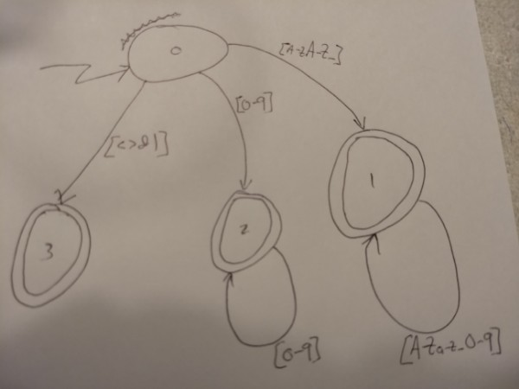

Slide 6
Code FSM using while and switch
char lexeme[BUFSIZ]; /* could put text here */
int getToken()
{
int inch;
while ((inch = getchar()) != EOF)
switch (inch)
{
…cases on next 2 slides
}
}

Slide 7
case ‘ ’:
case ‘\t’:
case ‘\n’:
break; /* skip white space */
case ‘&’:
case ‘|’:
case ‘<’:
case ‘>’:
return inch; /* Operators: use the character for the token */

Slide 8
/* #include <ctype.h> */
default:
if ( isdigit(inch) )
return parseNumber();
else if ( isalpha(inch) )
return parseWord();
parse_error(“Illegal character”, inch);

Slide 9
int parseNumber()
{
while (isdigit(peekc())
getchar();
return Number;
}
int parseWord()
{
while (isalnum(peekc())
getchar();
return Word;
}

Slide 10
Errors go to stderr
void parse_error(char *msg, char ch)
{
fprintf(stderr, “ERROR: %s: %c\n”, msg, ch);
}

Slide 11
Problem 1
Write a function, bool nextToken(String s), that recognizes string literals according to the following rules
Begins with a double quote
Ends with a double quote
has any characters inside
to embed a quote, include two quotes in a row, e.g.,
“She said ““Hello””” is She said “Hello”
“””” is “
“hello” is hello

Slide 12
bool nextToken() {
if (peek() == ‘“‘ )
while (true)
if (peek() == ‘“‘ ) {
getchar();
if ( peek() == ‘“‘ )
getchar();
else return true;
}
else if (isAlphaNum(peek()))
getchar()
else error();
}

Slide 13
Problem 2
Write a function, bool isBalanced(String s), that returns true only if the parenthesis in parameter s are correctly balanced. Handle three types of parens: () {} [] You can ignore any other characters in s.
isBalanced(“((([[[{{{}}}]]])))”); yields true
isBalanced(“[[[]]]{{{}}}((()))”); yields true
isBalanced(“((([[[{{{}}}]]]))”); yields false, missing )
isBalanced(“[[[]]]{{{}}}((())))”); yields false, extra )

Slide 14
Stack for Problem 2
class Stack {
Stack(); // constructs an empty stack (as linked list)
bool isFull(); // true iff this stack is full
bool isEmpty(); // true iff this stack is empty
char pop(); // removes and returns top item
char top(); // return top item without removing it
void push(char c); // adds c to top of this stack
}

Slide 15
bool isBalanced(string s) {
Stack S;
for (auto c : s) {
switch ( c ) {
case ‘(‘: S.push(‘)’); break;
case ‘[‘: S.push(‘]’); break;
case ‘{‘: S.push(‘}’); break;
case ‘)‘:case ‘]‘: case ‘}‘: if (S.isEmpty() || S.pop() != c ) return false; else break;
default:
error(“unknown char “, c);
return false;
}
}
return S.isEmpty();
}

